Slide 1
Implementation of Parallel Neural Networks using MPI
Arpita Welling

Slide 2
Dataset
Pima Indian Diabetes dataset (Kaggle)
Classifies a person as diabetic or non-diabetic
8 features:
Number of Pregnancies
Glucose concentration
Blood Pressure
Skin Thickness
Insulin level
BMI
Diabetes Pedigree function
Age
112,400 instances

Slide 3
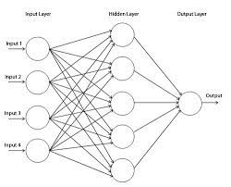
Neural Networks
3 basic layers: input layer, hidden layer(one or more), output layer
Input layer has multiple nodes, generally, equal to number of features of dataset (8 for this project)
1 hidden layer with 7 nodes
Output layer has 1 node

Slide 4
Sequential training of Neural Networks
Initialization
All layers and weight matrices are initialized to appropriate size
Forward Propagation
Values of one layer are multiplied by its weight and given as input to activation function
Output of activation function is given as input to next layer
Calculates error
Back Propagation
Errors are used to calculate the weight gradient
Weights are updated using weight gradient
Goes on till certain epochs are completed or until error rate is within desired limit

Slide 5
Types of Parallel Neural Network
Data Parallelism
Divides data between all processes.
Same model for all processes, different data
Model Parallelism
Divides nodes of each layer equally among all processes.
Same data is used by all process.

Slide 6
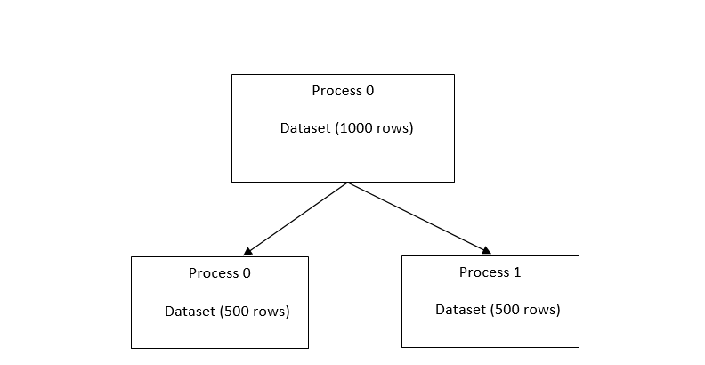
Parallel implementation of Neural Networks
Parallel: Data set can be distributed over N processes
Each process gets m/N instances of the data (m=length of data)
Weight gradients are communicated after each epoch
Accuracy is also communicated after all epochs

Slide 7
Use of MPI Communication collectives
Scatter: used to scatter data set
Broadcast: used to broadcast cost and data split information
allReduce: used to communicate gradients and accuracy
Barrier: used to synchronize processes after each epoch

Slide 8
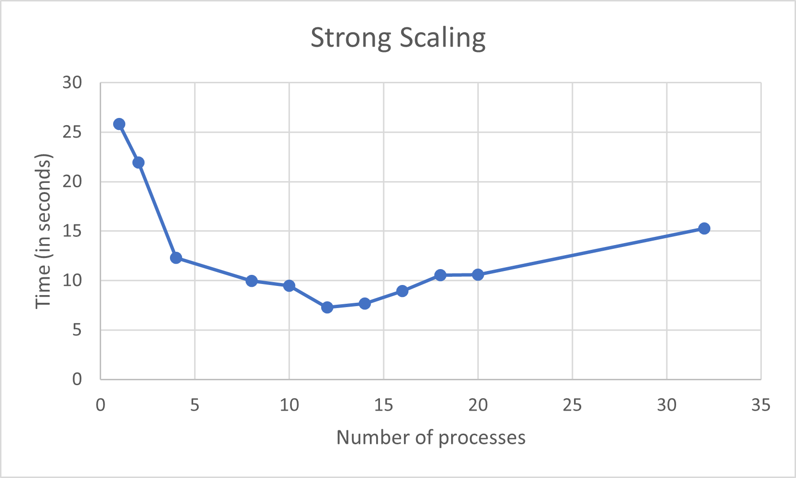
Results: Strong Scaling

Slide 9
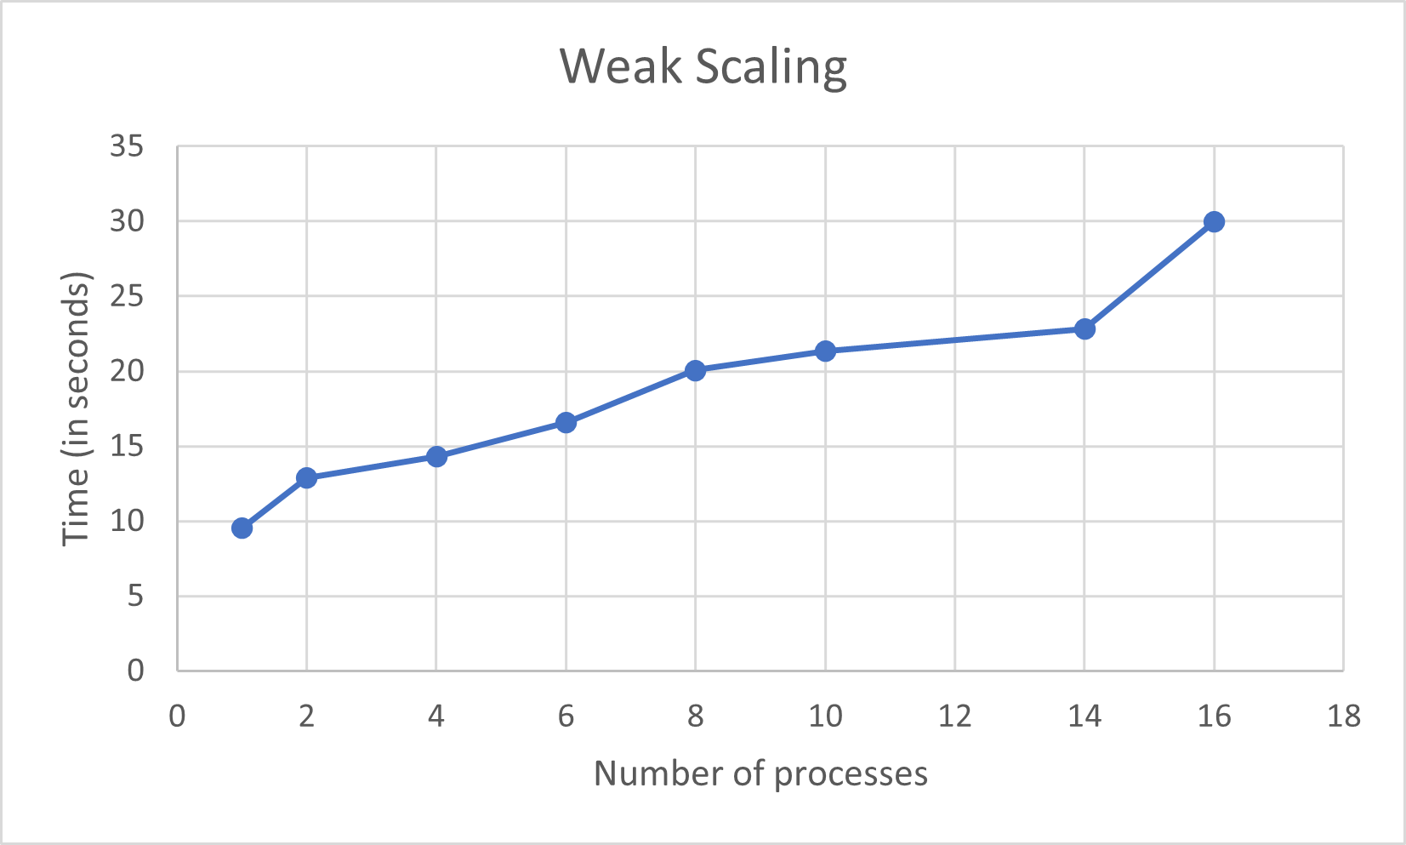
Results: Weak Scaling

Slide 10
Challenges
Overheads can slow down the parallel speedup
Speedup can be improved with large datasets
More number of hidden layers can also improve the speedup.

Slide 11
References
https://ieeexplore.ieee.org/abstract/document/1240376
https://arxiv.org/abs/1507.01239
https://www.academia.edu/24709347/Parallel_Training_of_Artificial_Neural_Networks_Using_Multithreaded_and_Multicore_CPUs
https://indjst.org/download-article.php?Article_Unique_Id=INDJST7582&Full_Text_Pdf_Download=True
https://pdeep.xyz/documents/Parallel_Deep_Learning_Pradeep_Singh.pdf
https://www.kaggle.com/uciml/pima-indians-diabetes-database

Slide 12
THANK YOU!

